Slide 1

--------------
Front-End Design Project
Age Calculator
Presenting By :D.TRISANTHI (Btech-CSE)

Slide 2

Agenda
Project Overview
Technical Stack
Screenshots
What I Learned

Slide 3

Project Overview
This project is designed to make users smile. With celebratory visuals, birthday music, and personalized messages, it turns a routine task into a moment of joy. It reflects my passion for building emotionally engaging web experiences.

Slide 4

Technical Stack
I
HTML
CSS
JavaScript
Semantic layout using <label>, <input>, <button>, and <div> for accessibility and clarity.
Responsive form design with fields for name, date of birth, and current date.
Embedded <audio> element for birthday music playback.
Gradient backgrounds and festive color palette to create a joyful atmosphere.
Responsive design with flexible layout and adaptive font sizes.
Layered z-index styling to manage visual depth (background blast, balloons, bubbles, card).
Dynamic age calculation using date arithmetic (years, months, days).
Conditional logic to detect birthdays and activate celebratory effects.
Timed effects using setTimeout() and setInterval() for continuous animations.

Slide 5

Here comes output of my project …
ddddddd

Slide 6
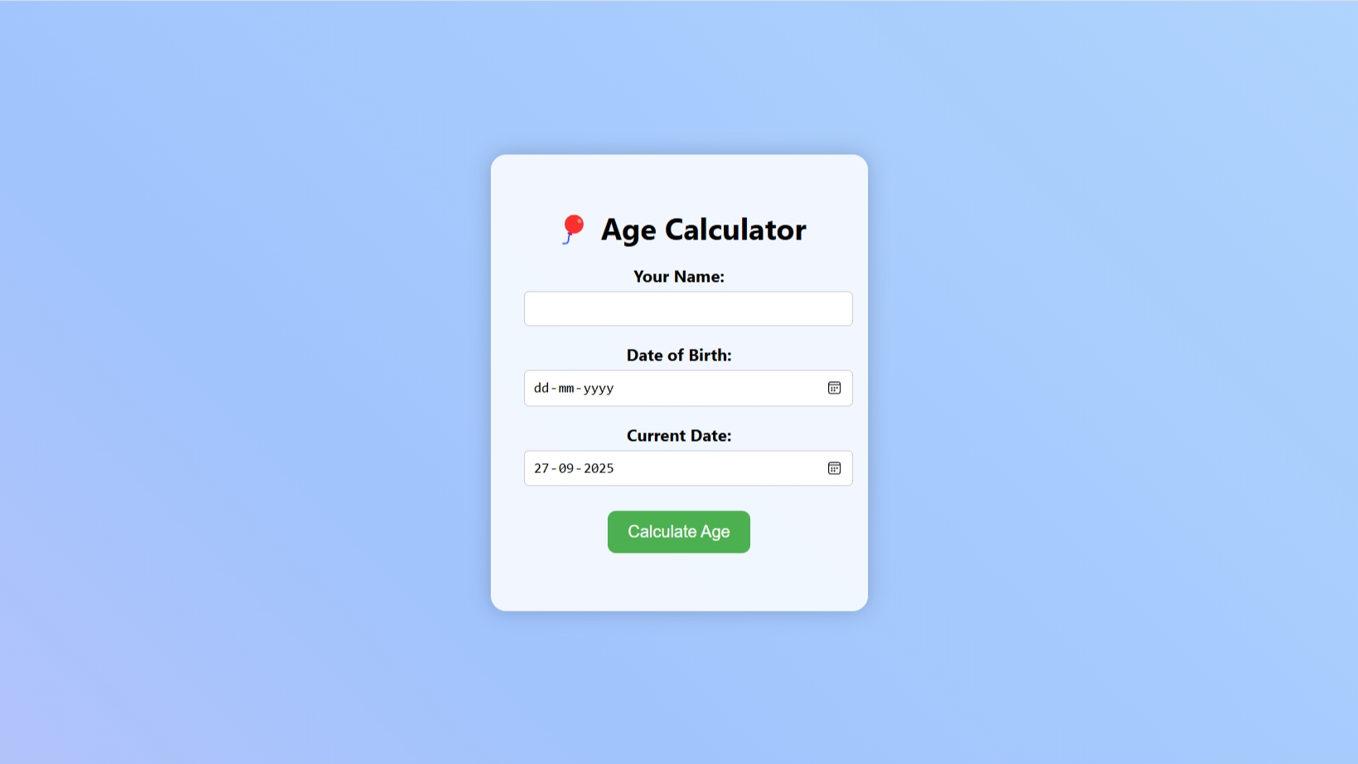

Slide 7
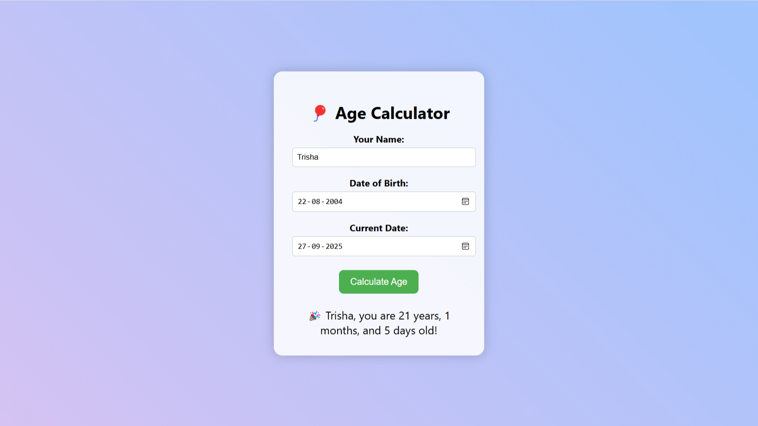

Slide 8
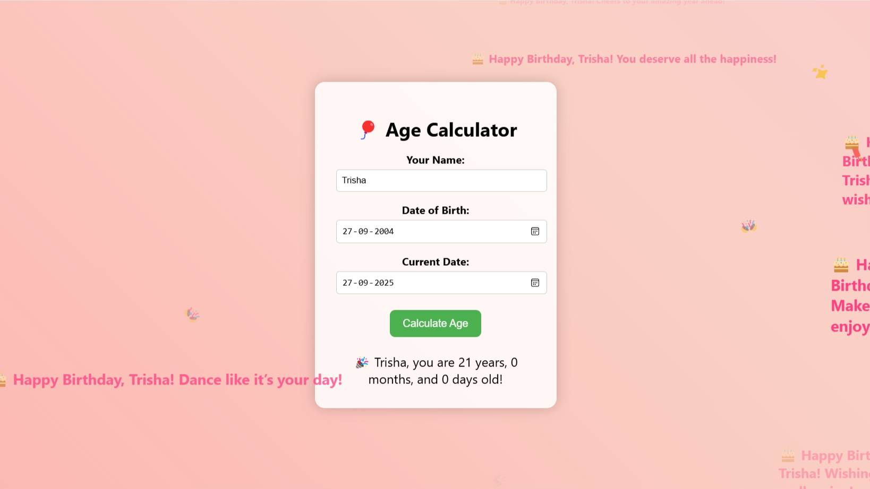

Slide 9

Conclusion
Age Calculator is a dynamic front-end project that blends functional utility with joyful user experience. It demonstrates my ability to:
Build responsive, user-friendly interfaces using HTML, CSS, and JavaScript
Implement precise date logic to calculate age accurately
Enhance user engagement through animations, sound, and personalized messages
Apply creative coding techniques to transform a simple tool into a delightful experience
This project reflects my commitment to crafting memorable web interactions and showcases my strengths in both technical execution and visual storytelling.

